Slide 1
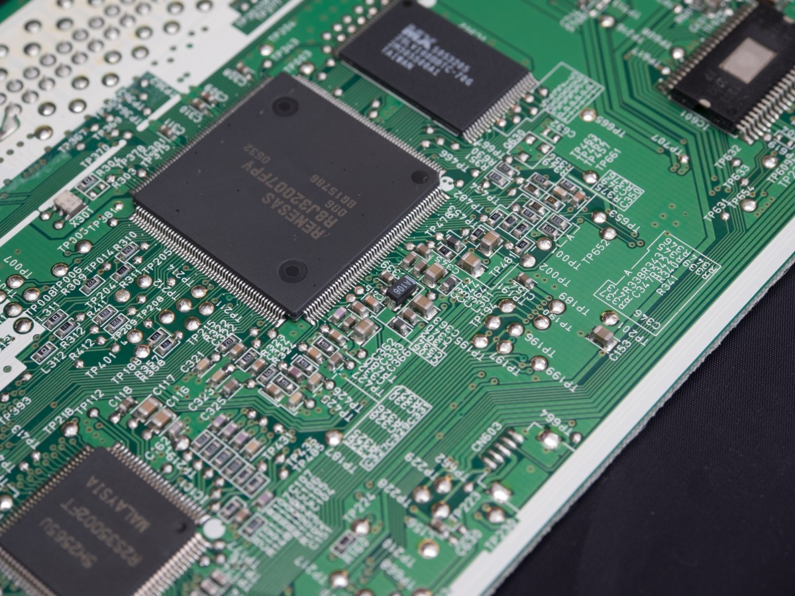

AVIONICS AND GNC
-JAIN NINAN & ANKIT NEGI

Slide 2

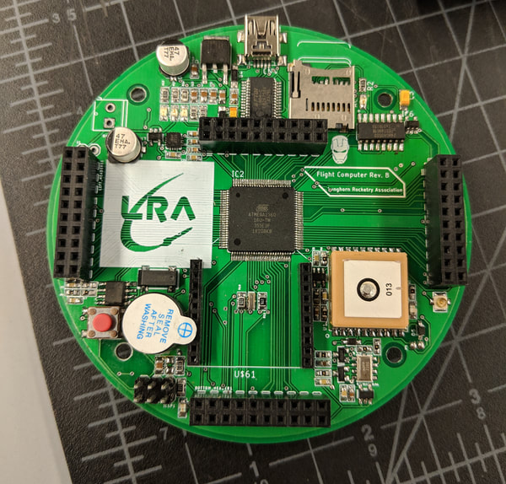
Role of ELECTRONIC SYSTEMS in Rocketry
Electronic systems play a crucial role in rocketry. They are used for a variety of functions, such as guidance, navigation, control, telemetry, communication, and safety.

Slide 3
GNC
Guidance and navigation systems use sensors and computer algorithms to determine the rocket's position, velocity, and orientation in space. They provide the necessary information to control the rocket's trajectory and ensure that it reaches its intended destination.
Control systems use electronic actuators to adjust the rocket's thrust, attitude, and trajectory. They are essential for ensuring that the rocket follows its planned flight path and stays on course.

Slide 4
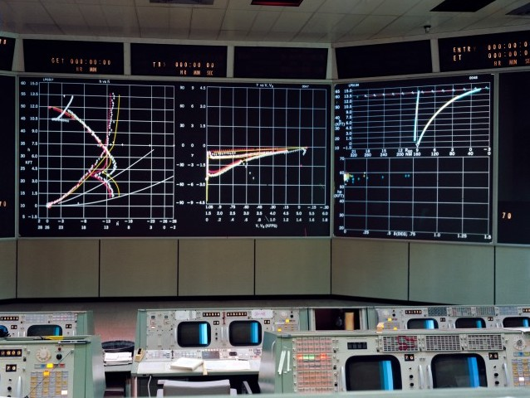
TELEMETRY
Telemetry systems use sensors and transmitters to send data from the rocket back to the ground. This data includes information about the rocket's position, velocity, temperature, pressure, and other important parameters. This data helps ground crews monitor the rocket's performance and make any necessary adjustments during the flight. Communication systems allow the rocket to receive commands from the ground and send telemetry data back to the ground. They are essential for controlling the rocket and ensuring that it remains on course.

Slide 5
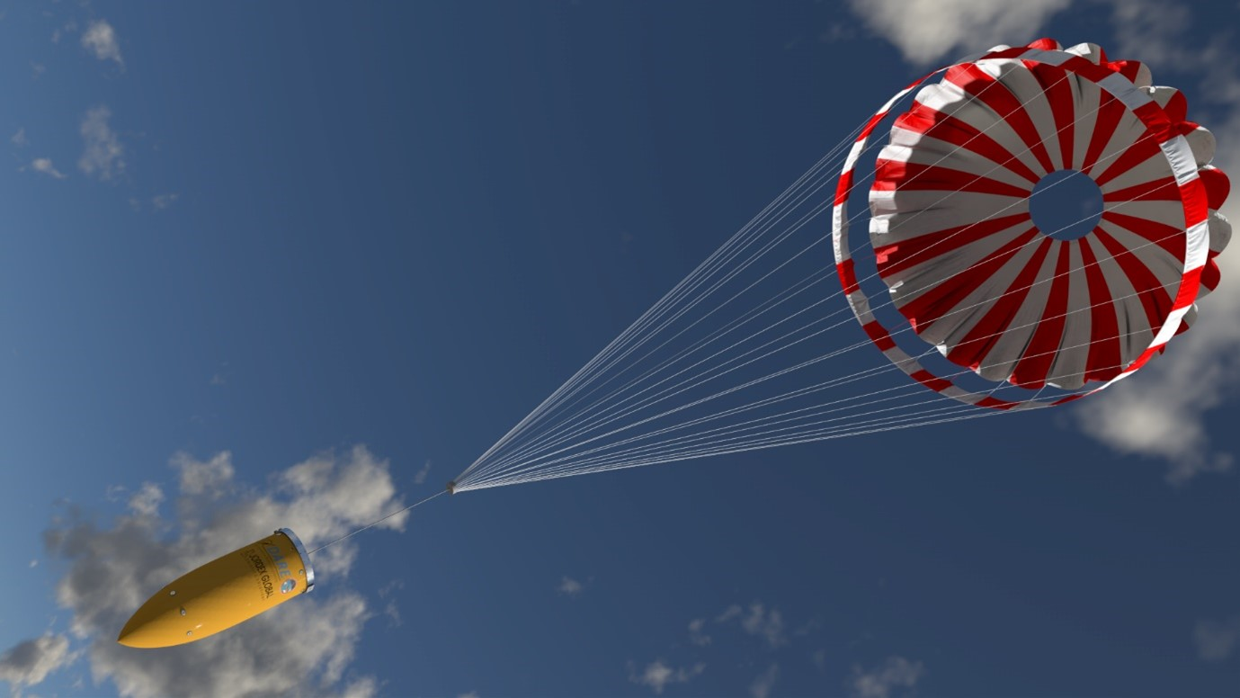
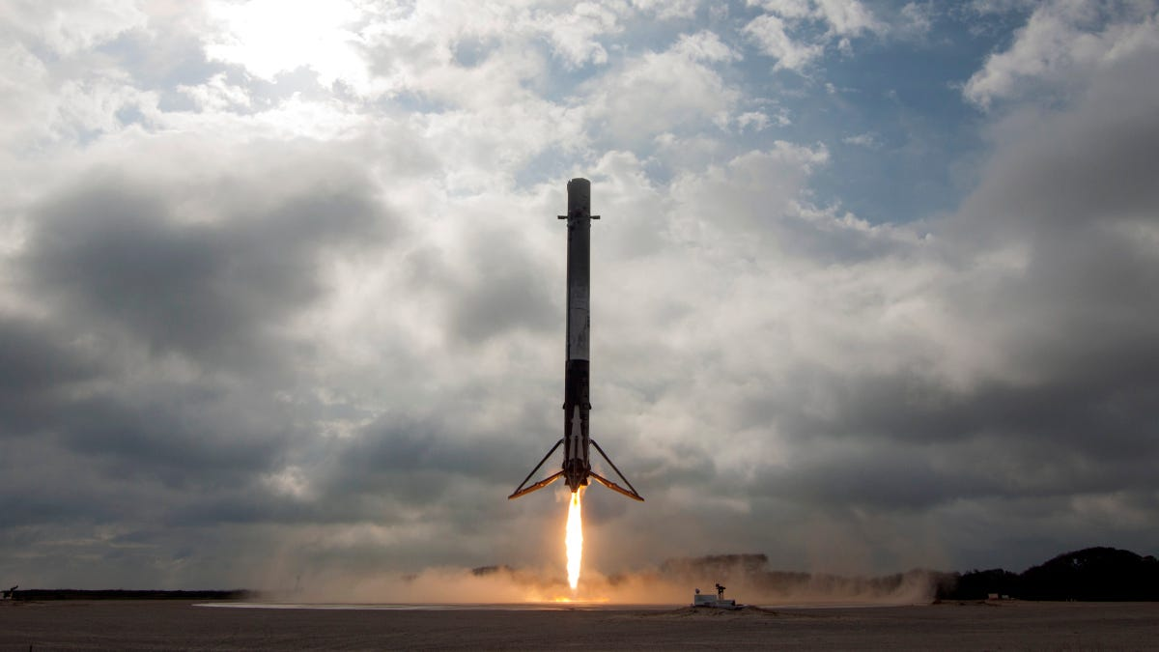
SAFETY AND RECOVERY
Safety systems use electronic sensors and algorithms to detect and prevent potential hazards. For example, they can detect anomalies in the rocket's performance and trigger automatic shutdown or abort procedures if necessary.
Recovery Systems includes parachute deployment and touch-down.
Overall, electronic systems play a critical role in ensuring the success and safety of rocket launches.

Slide 6
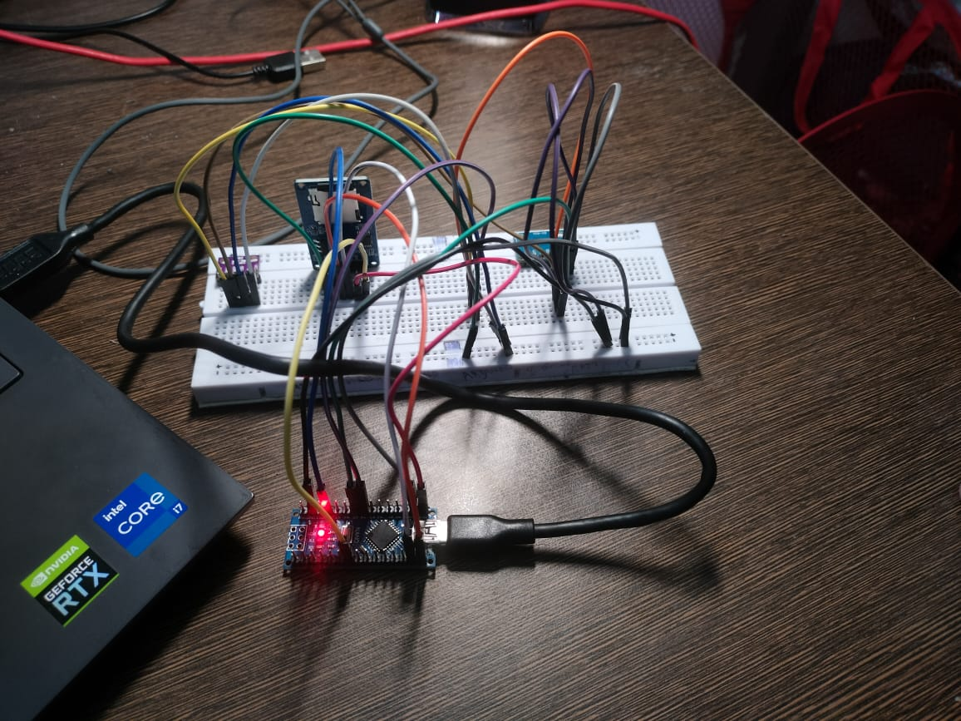
OUR SYSTEMS
EJECTION SYSTEM.
FLIGHT DATA.

Slide 7
EJECTION SYSTEM
We are using arduino nano, leds,
switchs, servo motors to eject the
parachute. When the rocket reaches the
apogee then automatically the parachute
is deployed for the recovery of the
rocket.

Slide 8
FLIGHT DATA
By using arduino nano, mpu6050, bmp280, sd card reader, we were able to record flight data in the sd card.

Slide 9
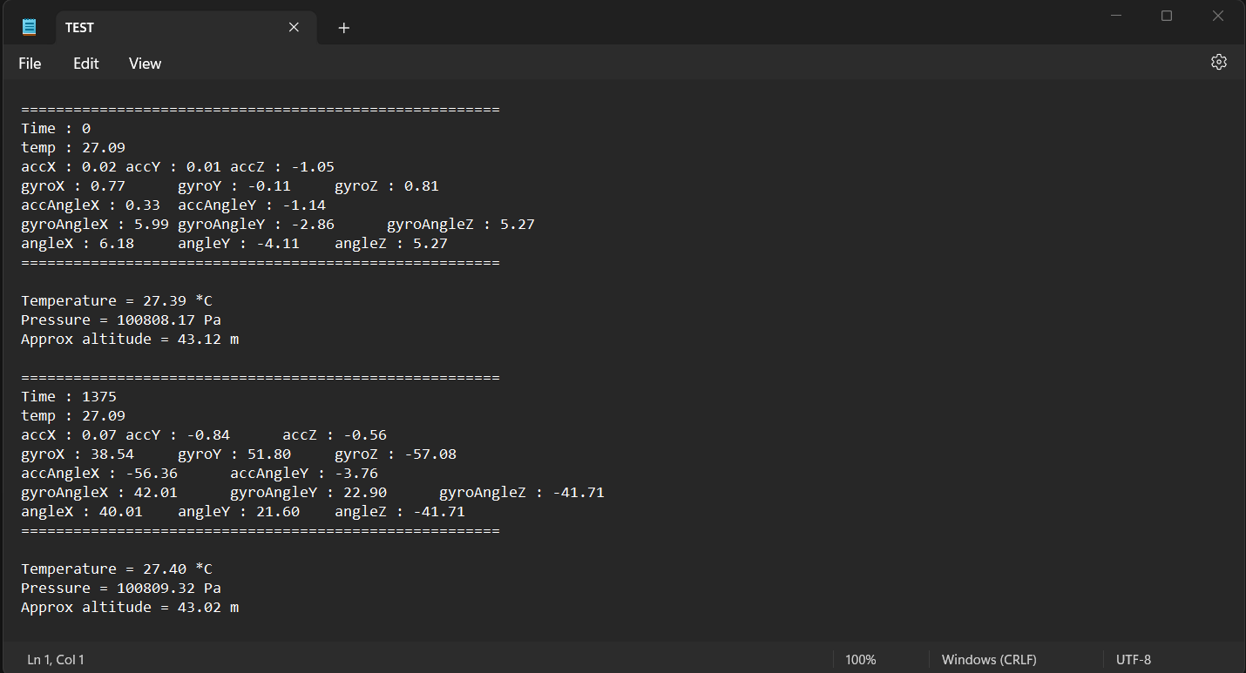
OUR FLIGHT COMPUTER DATA

